Slide 1
Module -01
Welcome

Slide 2
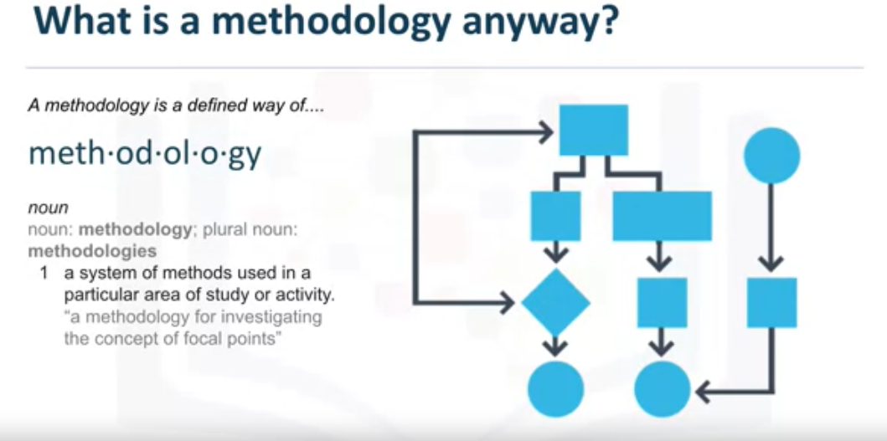

Slide 3
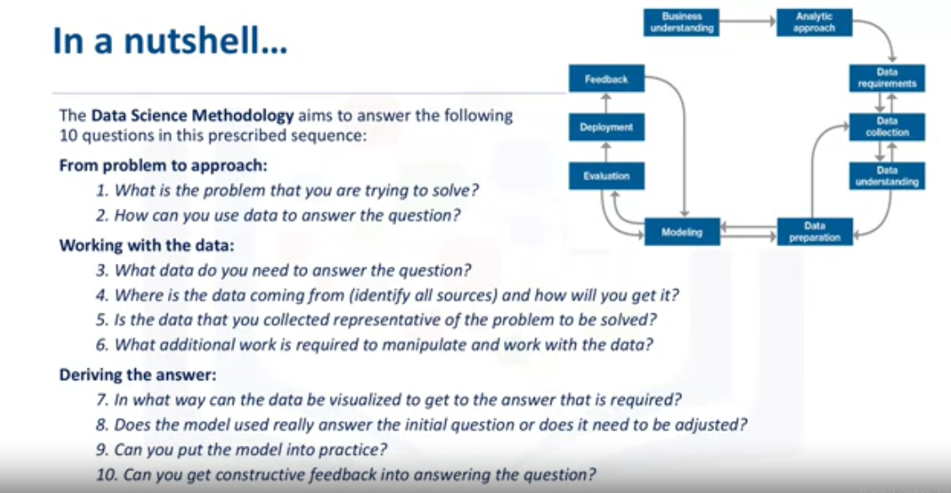

Slide 4
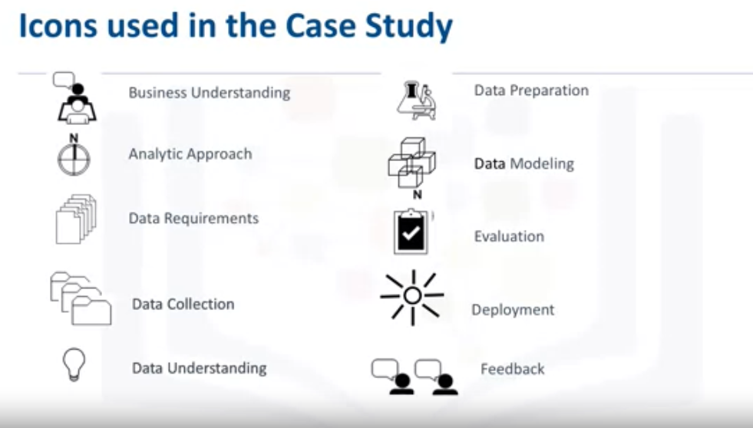

Slide 5
Module -01
From Problem to Approach

Slide 6
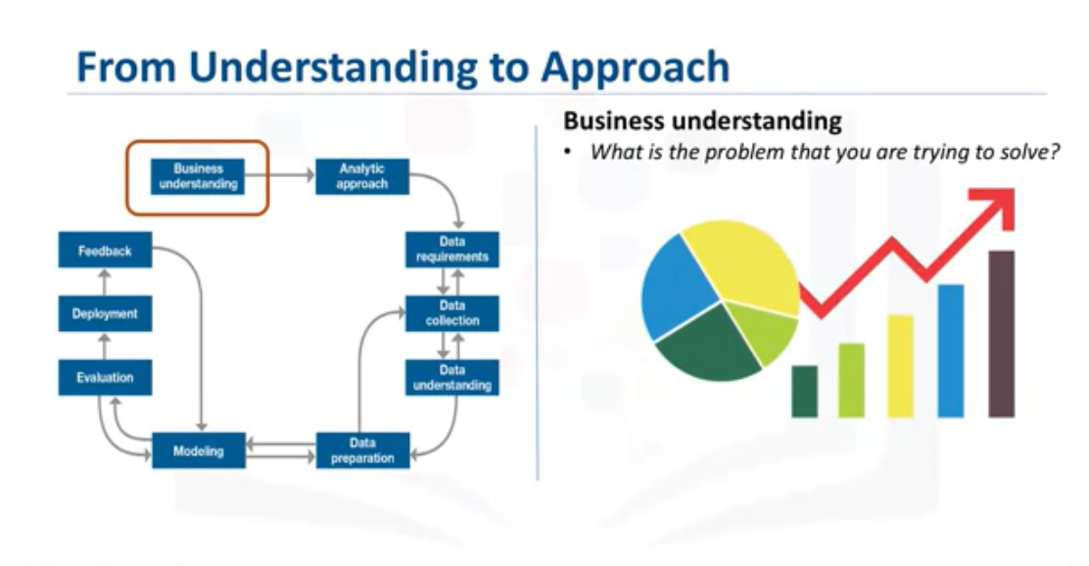
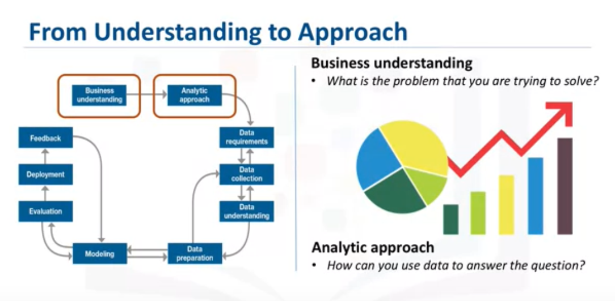
Stage-1

Slide 7
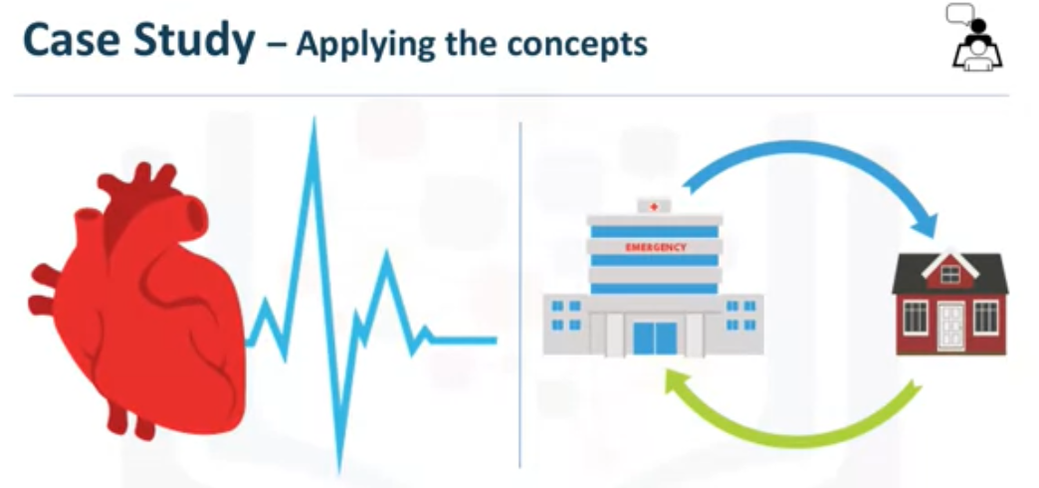
What is the best way to allocate the limited healthcare budget to maximize its use in providing quality care? This question is one that became a hot topic for an American healthcare insurance provider.

Slide 8
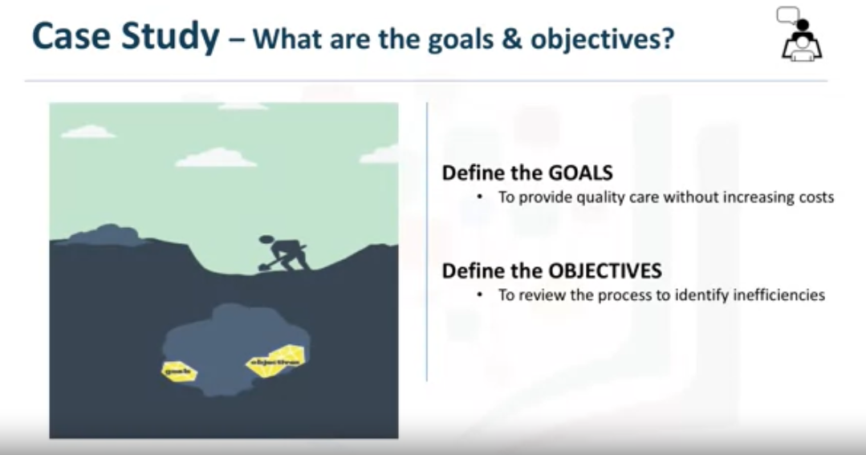

Slide 9
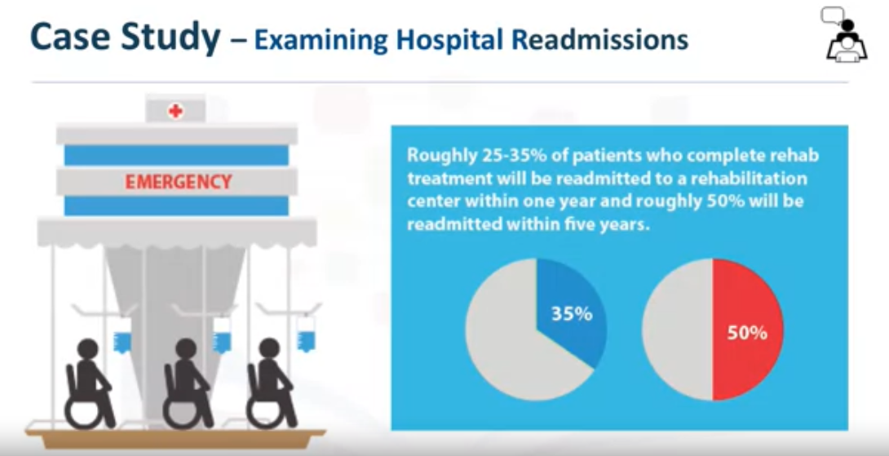

Slide 10
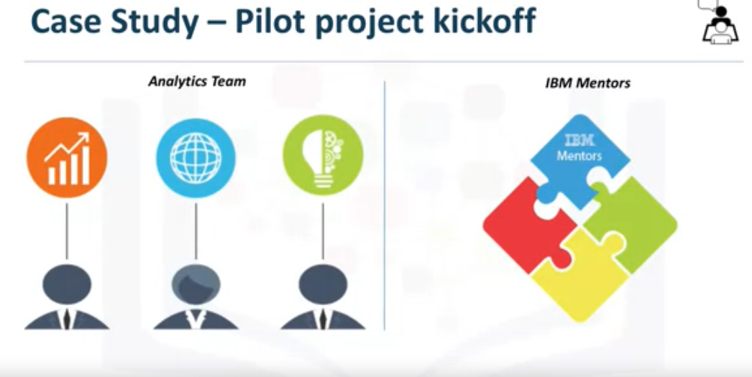
After reviewing some records, it was discovered that the
patients with congestive heart failure were at the top of the readmission list. It was further determined that a decision-tree model could be applied to review this scenario, to determine why this was occurring. To gain the business understanding that would guide the analytics team in formulating and performing their first project, the IBM Data scientists, proposed and delivered an on-site workshop to kick things off

Slide 11
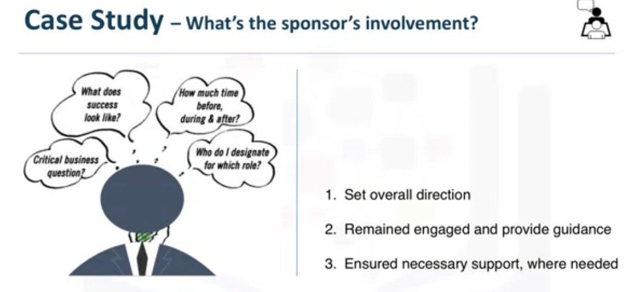
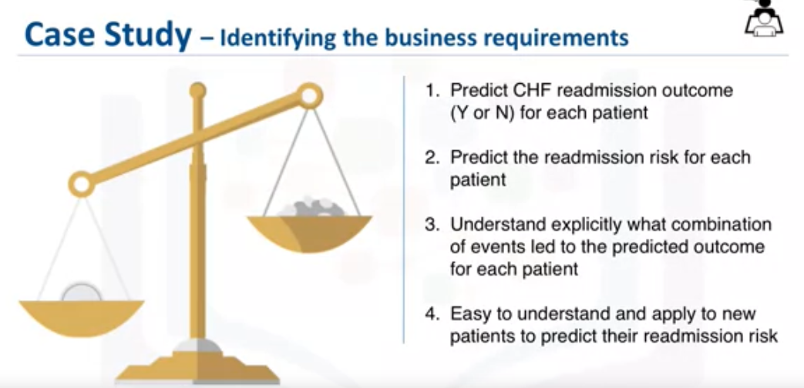

Slide 12
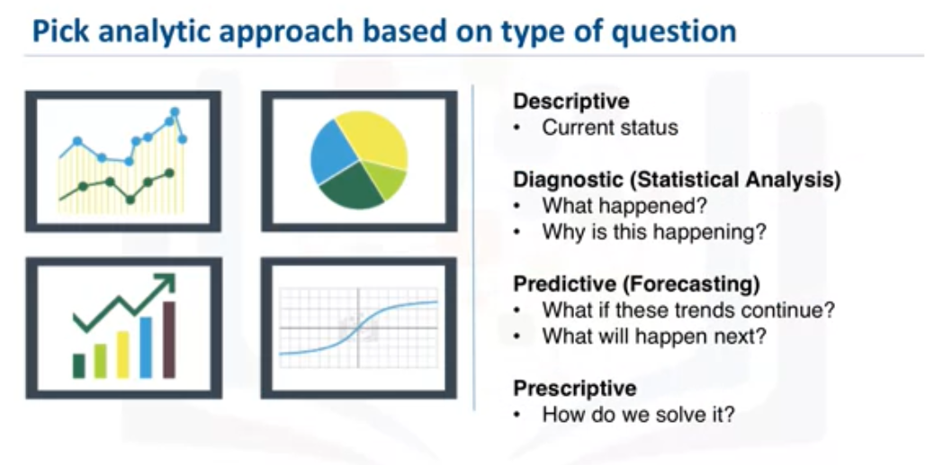
Stage-2

Slide 13
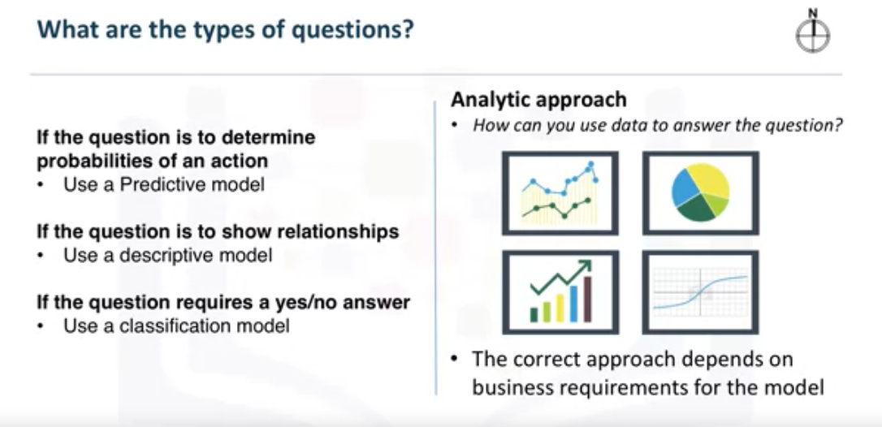
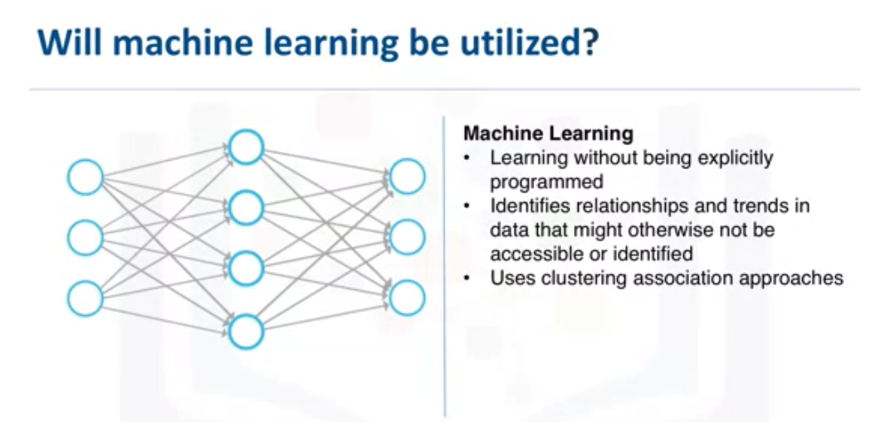

Slide 14
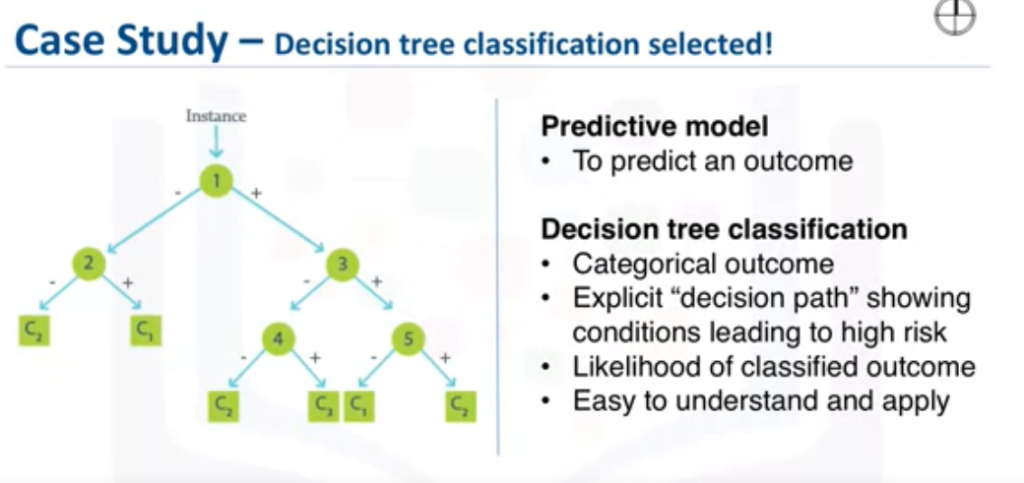
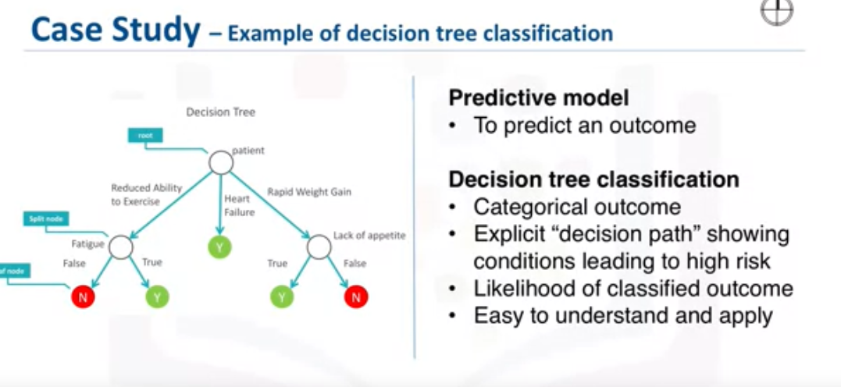

Slide 15
In this lesson, you have learned:
The need to understand and prioritize the business goal.
The way stakeholder support influences a project.
The importance of selecting the right model.
When to use a predictive, descriptive, or classification model.

Slide 16
Module -01
From Requirements to Collection

Slide 17
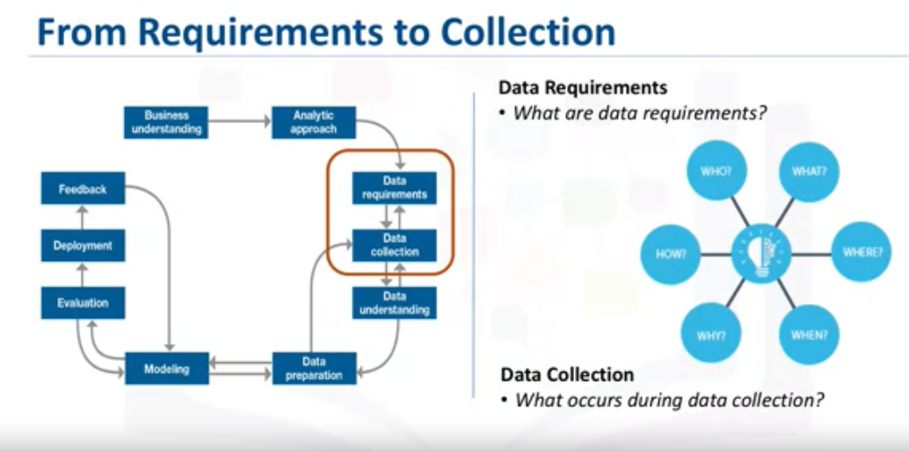
Stage-3

Slide 18
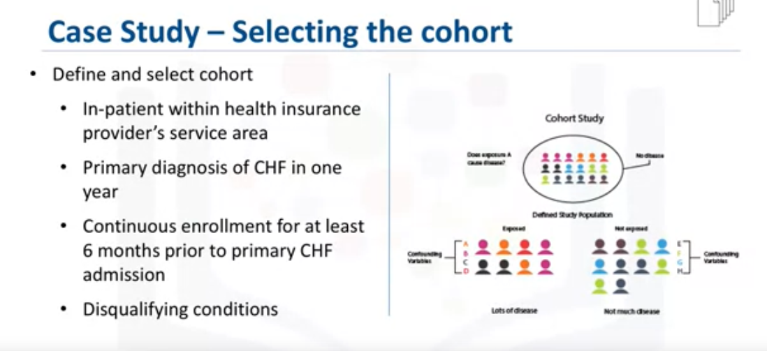
Congestive heart failure patients who also had been diagnosed as having other significant medical conditions, were excluded from the cohort because those conditions would cause higher-than-average re-admission rates and, thus, could skew the results. Then the content, format, and representations of the data needed for decision tree classification were defined. This modeling technique requires one record per patient, with columns representing the variables in the model. To model the readmission outcome, there needed to be data covering all aspects of the patient's clinical history.

Slide 19
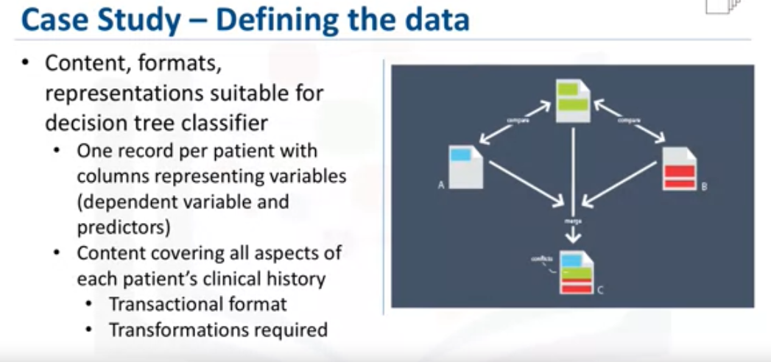

Slide 20

Stage-4

Slide 21
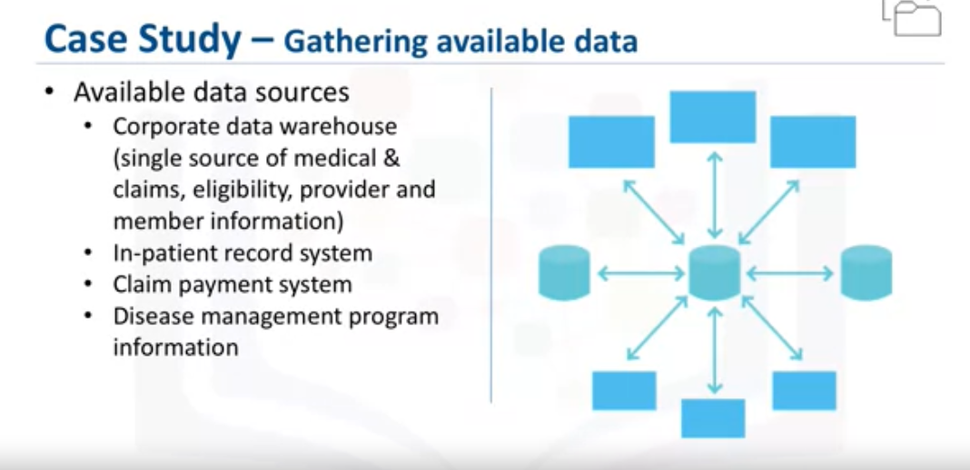
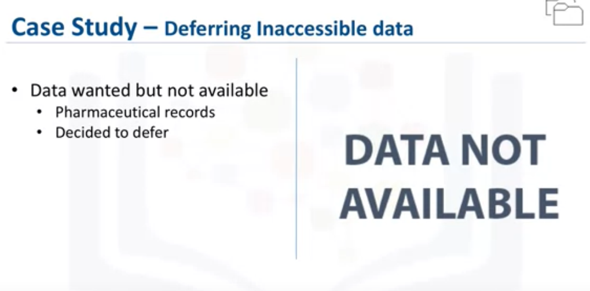

Slide 22
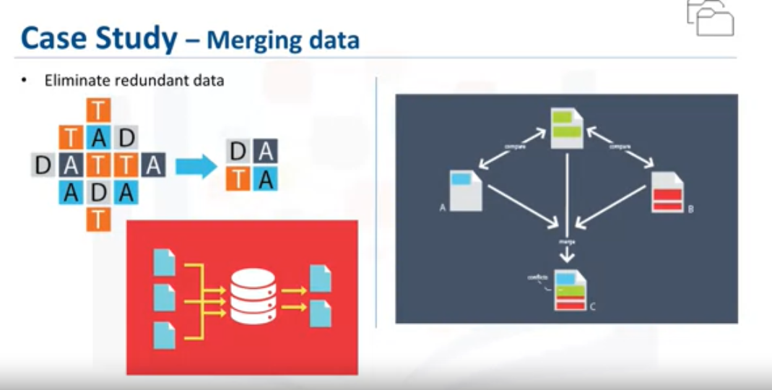

Slide 23
Lesson Summary
The significance of defining the data requirements for your model.
Why the content, format, and representation of your data matter.
The importance of identifying the correct sources of data for your project.
How to handle unavailable and redundant data.
To anticipate the needs of future stages in the process.

